Slide 1
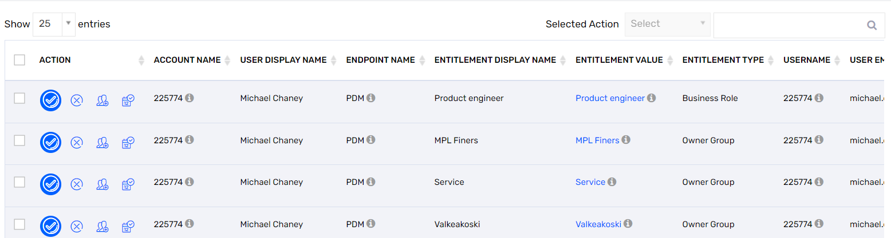
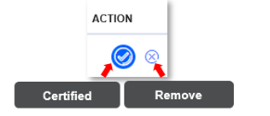
PDM Access Review
What is access check review?
Purpose of access check is to remove unncessary access who do not need access for PDM application
Why you have received email?
Reason for receiving this email, you have subordinate/Line Manager who are using / used the PDM system.
What you need to do
Review list of access for each users and validate
Removing access helps to avoid unnecssary email
Its part of Valmet global security policy
if they need the same access (Role,product access, ERP etc) for his job?
Or having unnecessary access?
Have more access than his responsibility?
Click Certified , If user still required access
Click remove, If user do not need the access
More Details

Slide 2



PDM Data Access control elements
Business Role: Defines what kind of system functions user could excute.This based on the user job description.
Reader business role is not able to modify data even there is owner group (not RTD owner group)assigned in his account.
Detail defination of each business role could be found in this link. Description on PDM Business Roles
Owner Group: Defines what kind of data user could edit.This based on the user job description.
Every user should have compass system in the owner group list.
Only item specialist who maintain VAL and GDI items information could get Commercial item and Global item Owner Group.
Only translator could get owner group which name contains * translation
If user is aiming to view the data in PDM system,please consider to give the viewing group right instead of Owner Group rights.
For the data in RTD Owner group should be assigned to user for both viewing(business role is reader) and editing(other engineering roles) purpose.
Define customer information request Owner Group right
Localize BOM is request OG rights
Detail defination of each owner group could be found in this link. Description on PDM Entitlements in Idefix
Viewing Group: Defines what kind of data user could view.This based on the user job description.
Consider whether the other owner group data which are included in selected viewing group is suitable for user or not.
Detail defination of each viewing group could be found in this link. PDM Access - Owner group and corresponding viewing group list
Market Area: limit the data inside of viewing group which could be viewed by user.This based on the user working area.
ERP company: Give the access to user for transfer data to defined ERP company and viewing logistic data from ERP company. Meanwhile, for user who is creating Notification(EO,PN,ECN) to Sovelia should have proper ERP company in the account.
Viewing Group
Owner Group
MA1
MA2
Owner group 1
Owner group 2
Owner group 1
Owner group 2
Data 1- Market Area 1
Data 3- Market Area 3
Data 4- Market Area 1
Data 6- Market Area 3
Data 2- Market Area 2
Data 5- Market Area 2
MA=world

